Slide 1
Micro Credit defaulter Project

Slide 2
contents
Problem Statement
Definition of Micro Credit
Importance of Micro Credit Model
Exploratory data analysis(EDA)
Visualization
Data cleaning
Model Building
ROC-AUC Curve
Hyper parameter Tuning
How to save the Model
Conclusion

Slide 3
Problem statement
A Microfinance Institution (MFI) is an organization that offers financial services to low income populations. MFS becomes very useful when targeting especially the unbanked poor families living in remote areas with not much sources of income. The Microfinance services (MFS) provided by MFI are Group Loans, Agricultural Loans, Individual Business Loans and so on.
Many microfinance institutions (MFI), experts and donors are supporting the idea of using mobile financial services (MFS) which they feel are more convenient and efficient, and cost saving, than the traditional high-touch model used since long for the purpose of delivering microfinance services. Though, the MFI industry is primarily focusing on low income families and are very useful in such areas, the implementation of MFS has been uneven with both significant challenges and successes.

Slide 4
We are working with one such client that is in Telecom Industry. They are a fixed wireless telecommunications network provider. They have launched various products and have developed its business and organization based on the budget operator model, offering better products at Lower Prices to all value conscious customers through a strategy of disruptive innovation that focuses on the subscriber.
The Consumer is believed to be defaulter if he deviates from the path of paying back the loaned amount within the time duration of 5 days. For the loan amount of 5 (in Indonesian Rupiah), payback amount should be 6 (in Indonesian Rupiah), while, for the loan amount of 10 (in Indonesian Rupiah), the payback amount should be 12 (in Indonesian Rupiah).
The sample data is provided to us from our client database. It is hereby given to you for this exercise. In order to improve the selection of customers for the credit, the client wants some predictions that could help them in further investment and improvement in selection of customers.

Slide 5
What is micro credit?
Microcredit is a common form of microfinance that involves an extremely small loan given to an individual to help them become self-employed or grow a small business. These borrowers tend to be low-income individuals, especially from less developed countries (LDCs). Microcredit is also known as "micro lending" or "microloan."

Slide 6
Exploratory data analysis(eda)
Step 1: Import the dataset
Step 2: Perform statistical analysis like checking the shape and information about the data
Step 3: Check for null values in the dataset
Step 4: Dropped the columns that had many zeros as it would cause a lot of skewness
Step 5: Extracted the Day and month from the date column
Step 6: Converted the negative values to positive values using absolute method(abs)

Slide 7
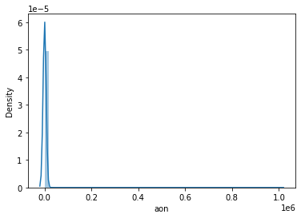
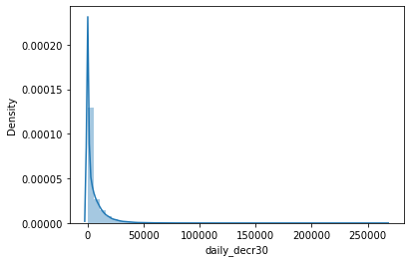
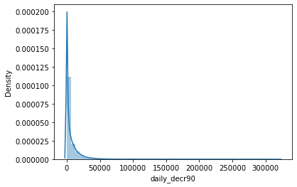
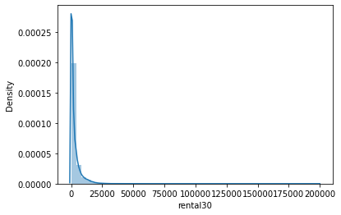
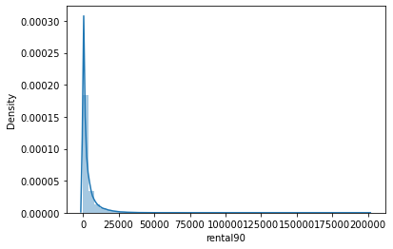
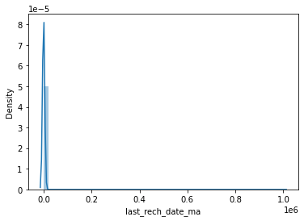
Visualization

Slide 8
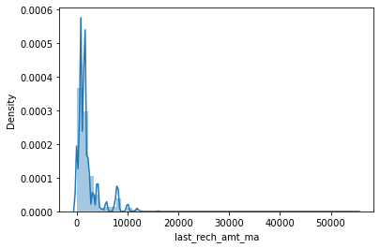
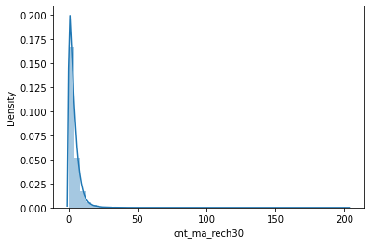
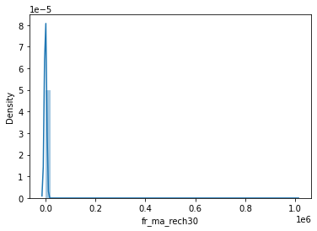
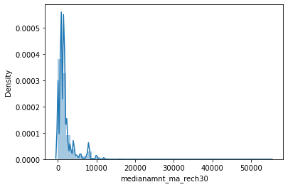
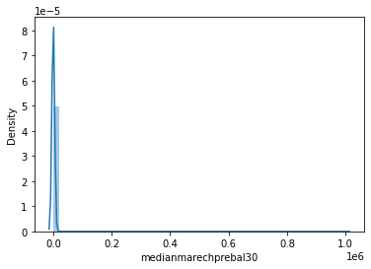


Slide 9
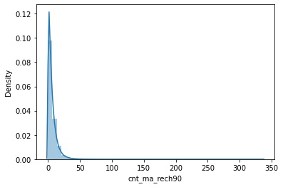
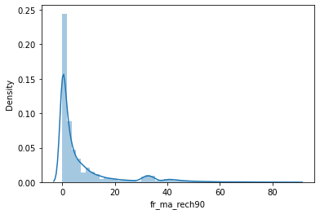
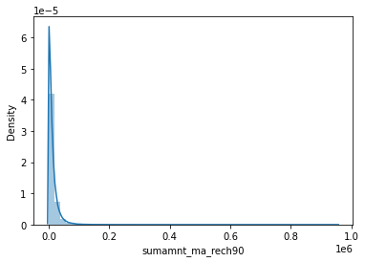
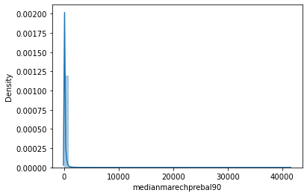
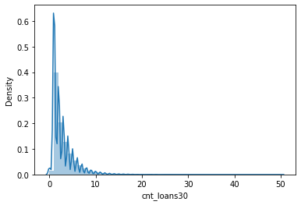


Slide 10
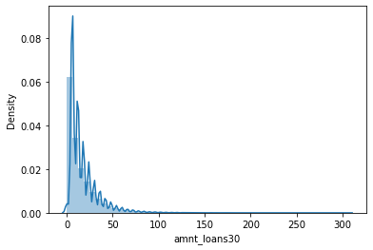
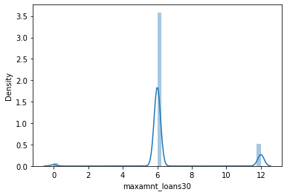
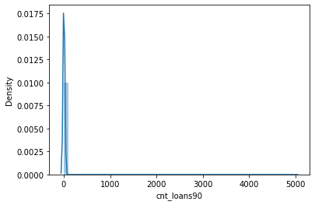
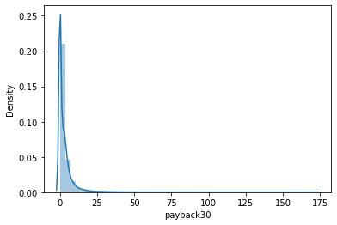

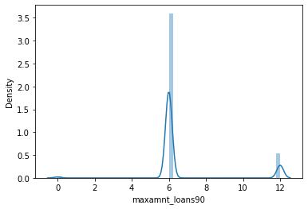

Slide 11

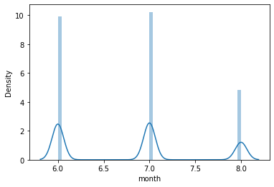
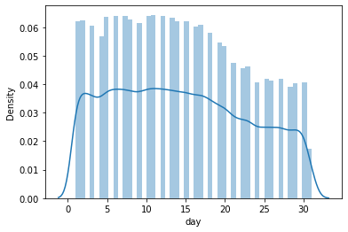
From all the above distribution plots we see that all the features have skewness.

Slide 12
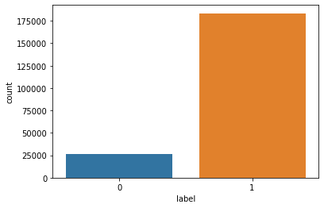
The target column that is, “label” as seen in the above count plot has a lot of data imbalance

Slide 13
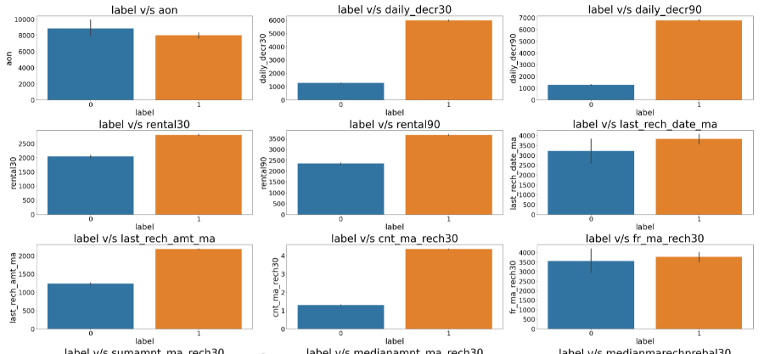
Bivariate analysis

Slide 14
Observations:
We can see that the number of defaulters are more with high value of age.
Customers with high value of Daily amount spent from main account, averaged over last 30 days (in Indonesian Rupiah)(daily_decr30) are maximum Non-defaulters.
Customers with high value of Daily amount spent from main account, averaged over last 90 days (in Indonesian Rupiah)(daily_decr90) are maximum Non-defaulters.
Customers with high value of Average main account balance over last 30 days(rental30) are maximum Non-defaulters.
Customers with high value of Average main account balance over last 90 days(rental90) are maximum Non-defaulters.
Customers with high Number of days till last recharge of main account(last_rech_date_ma) are maximum Non-defaulters.
Customers with high value of Amount of last recharge of main account (in Indonesian Rupiah)(last_rech_amt_ma) are maximum Non-defaulters.
Customers with high value of Number of times main account got recharged in last 30 days(cnt_ma_rech30) are maximum Non-defaulters.
Customers with high value of Frequency of main account recharged in last 30 days(fr_ma_rech30) are maximum Non-defaulters.

Slide 15
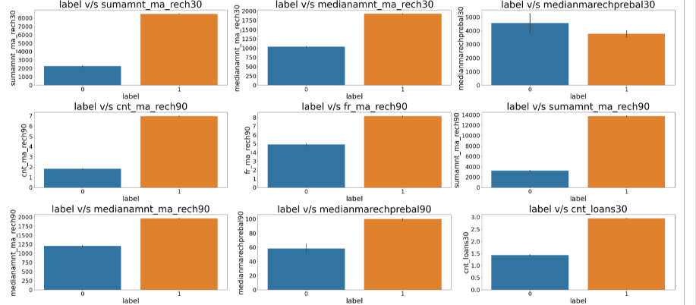

Slide 16
Observations
Customers with high value of Total amount of recharge in main account over last 30 days (in Indonesian Rupiah)(sumamnt_ma_rech30) are maximum Non-defaulters.
Customers with high value of Median of amount of recharges done in main account over last 30 days at user level (in Indonesian Rupiah)(medianamnt_ma_rech30) are maximum Non-defaulters.
Customers with high value of Median of main account balance just before recharge in last 30 days at user level (in Indonesian Rupiah)(medianmarechprebal30) are maximum defaulters.
Customers with high value of Number of times main account got recharged in last 90 days(cnt_ma_rech90) are maximum Non-defaulters
Customers with high value of Frequency of main account recharged in last 90 days(fr_ma_rech90) are maximum Non-defaulters
Customers with high value of Total amount of recharge in main account over last 90 days (in Indonesian Rupiah)(sumamnt_ma_rech90) are maximum Non-defaulters.
Customers with high value of Median of amount of recharges done in main account over last 90 days at user level (in Indonesian Rupiah)(medianamnt_ma_rech90) are maximum Non-defaulters.
Customers with high value of Median of main account balance just before recharge in last 90 days at user level (in Indonesian Rupiah)(medianmarechprebal90) are maximum Non-defaulters.
Customers with high value of Number of loans taken by user in last 30 days(cnt_loans30) are maximum Non-defaulters

Slide 17
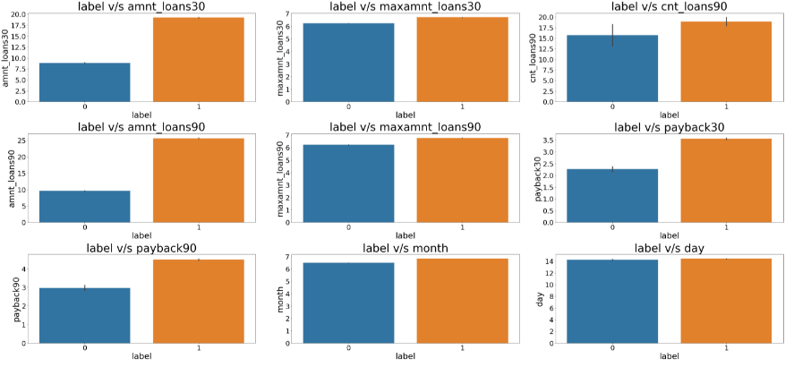

Slide 18
Observations
Customers with high value of Total amount of loans taken by user in last 30 days(amnt_loans30) are maximum Non-defaulters.
Customers with high value of maximum amount of loan taken by the user in last 30 days(maxamnt_loans30) are maximum Non-defaulters.
Customers with high value of Number of loans taken by user in last 90 days(cnt_loans90) are maximum Non-defaulters.
Customers with high value of Total amount of loans taken by user in last 90 days(amnt_loans90) are maximum Non-defaulters.
Customers with high value of maximum amount of loan taken by the user in last 90 days(maxamnt_loans90) are maximum Non-defaulters.
Customers with high value of Average payback time in days over last 30 days(payback30) are maximum Non-defaulters.
Customers with high value of Average payback time in days over last 90 days(payback90) are maximum Non-defaulters.
In between 6th and 7th month maximum customers both defaulters and Non-defaulters have paid there loan amount.
Below 14th of each month all the customers have paid there loan amount.

Slide 19
Data cleaning
The dataset that was provided did not have any null values but had a lot of skew data
I used the Zscore method to remove the outliers
I thenk checked the skewness and reduced the skewness by using PowerTansformer

Slide 20
Model building
We will now use classification models since out target contains categorical data. The below list algorithms are what I’ve used in my project.
Decision Tree Classifier
Random Forest Classifier
Logistic Regression
XG Boost Classifier
AdaBoost Classifier

Slide 21
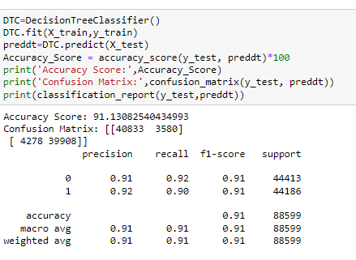
We got an accuracy of 91.13% using decision tree classifier.

Slide 22
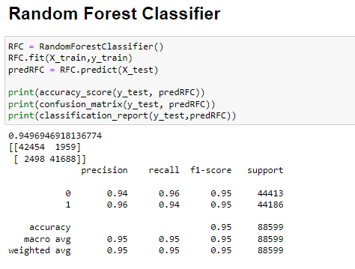
We get an accuracy score of 94.96% using Random forest classifier.

Slide 23
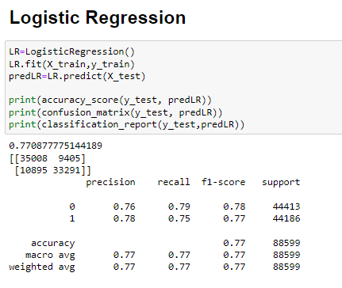
We get an accuracy score of 77.08% using logistic regression.

Slide 24
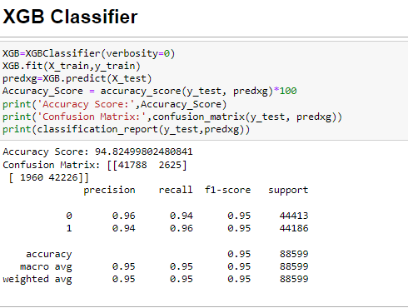
We get accuracy score of 94.82% using XG Boost classifier.

Slide 25
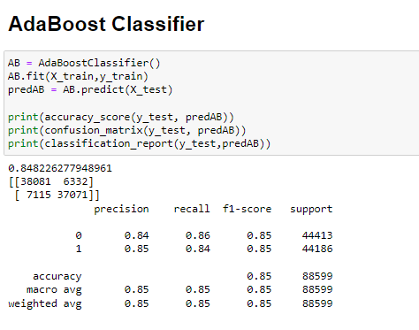
We get accuracy score of 84.82% using Ada Boost Classifier.

Slide 26
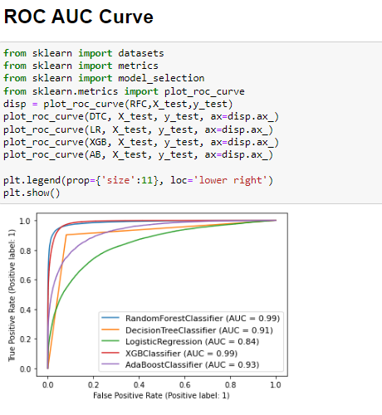
As we can see the AUC value is the highest for Random Forest Classifier.

Slide 27
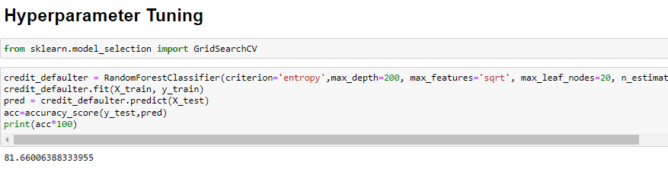
I tried a lot of combinations but the accuracy score did not increase using Hyper parameter tuning.

Slide 28

Saving the model
We save the model using pickle.
We can save the model by following th code that is in the below image.

Slide 29
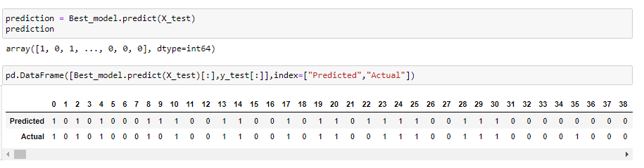
Prediction results
The following is the prediction results that I got by using Random forest classifier.

Slide 30
Conclusion
In this project, we have used different classification algorithms to predict if a customer is a credit defaulter or not.
After building different model, we came to conclusion that Random Forest Classifier is the best model for this project and gave us an accuracy score of 94.96%.
We also saved the best model and printed the prediction results according to our model.

